Slide 1
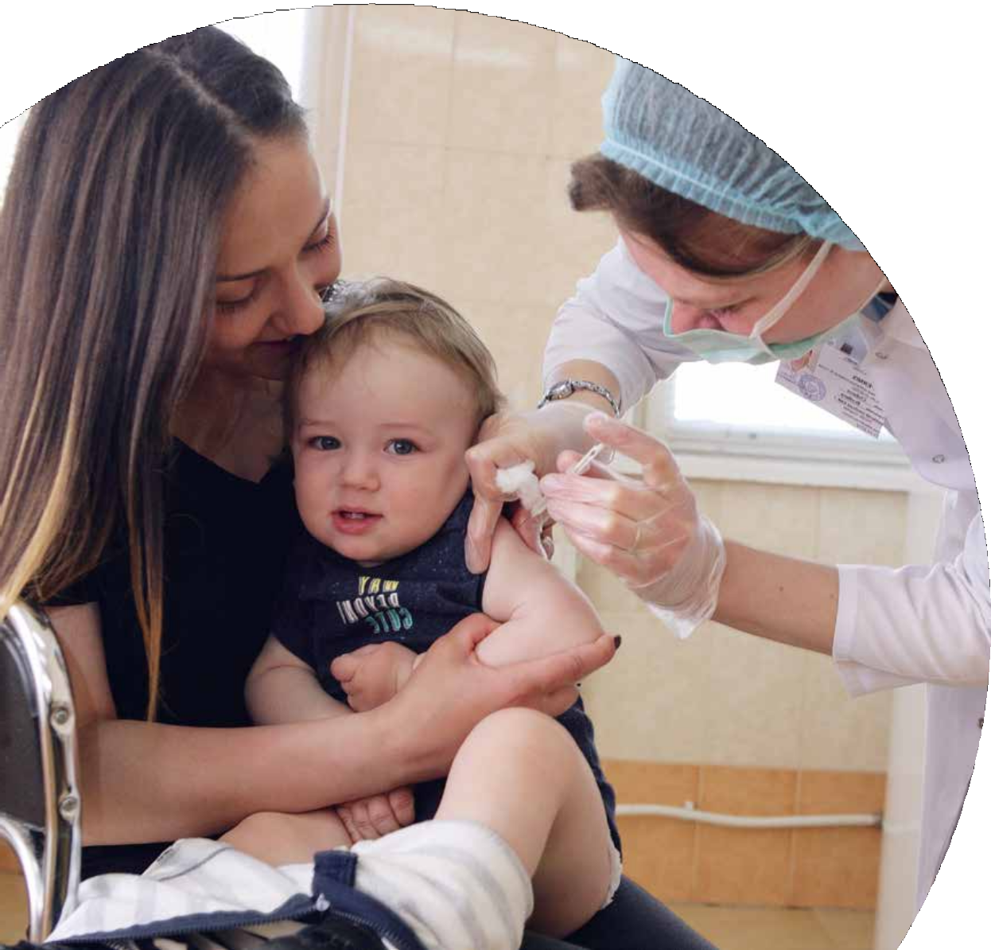

For Every Child, Health
Desiree Jongsma,
UNICEF Country Representative in Moldova
8 June 2018

Slide 2
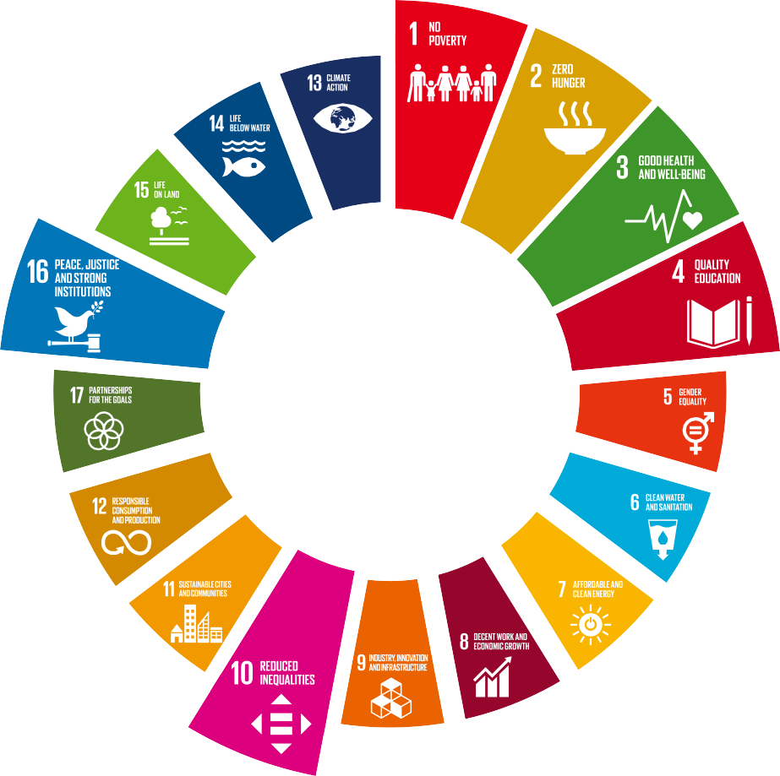
The Sustainable Development Goals
Notes:
Child care cannot be achieved by a single sector, being of key importance is intersectoral collaboration to ensure the realization of SDGs on the reduction of inequalities and child poverty, a healthy life and the wellbeing of children, inclusive and equitable education, adequate access to child-friendly justice and the accountability of institutions.

Slide 3

Nurturing care
Selected Key Achievements 2017
Guidelines on Home Visiting, including child and family wellbeing assessment tools, were developed with UNICEF support and approved by MHLSP
The maternal health regulatory framework was further strengthened with the development of antenatal care standards on the left bank of Nistru river
30 health professionals from left bank of Nistru river acquired skills in using evidence-based data for development of local standards
Way Forward 2018
Expand access to effective and essential Early Childhood Development services: scale up early intervention services to 10 districts in Moldova
Nurses and Family Doctors to acquire enhanced skills to provide Home Visiting programmes and improve good nutrition and positive parenting skills of mothers and fathers
Pre-service and In-service curricula of nurses and family doctors to include new child care and development standards, including home visiting
30 health professionals from the left bank of Nistru river being trained in implementation of antenatel care standards

Slide 4


Immunization
Selected Key Achievements 2017
>1,389K Vaccine doses acquired through UNICEF supported mechanism
384 Health Professionals aquired enhanced skills in interpersonal communication
Communication and Behavior Change strategy to increase demand for immunization developped with UNICEF support and approved by the MHLSP
Way Forward 2018
Procurement of >1,330K vaccine doses and 52 cold chain equipment through UNICEF procurement mechanism
Support in implementation of the Communication and Behavior Change strategy to increase demand for immunization
Support the functioning of the intersectoral platform to increase demand for immunization services
Adjust medical university/college curricula to build interpersonal communication skills in health workers

Slide 5


Youth Friendly Health Services (YFHS)
Selected Key Achievements 2017
A performance-based financing (PBF) pilot for YFHS was initiated and qualitative and quantitative PBF indicators were developed and tested in four pilot centres.
YFHS Communication for Behaviour Change (C4BC) Strategies were adopted by Local Public Authorities (LPAs) in five districts to boost health seeking behaviours among adolescents.
Way Forward 2018
Piloting of the performance based payment mechanism for Youth Friendly Health Services in four districts
15% increase in YFHS able to provide services to the most vulnerable and at risk groups of adolescents
Strengthen the referral system for most vulnerable and at risk groups of adolescents in 10 districts
Support the MHLSP in the validation status of eMTCT of HIV infection in the Republic of Moldova
Notes:
eMTCT elimination of Mother to Child Transmission

Slide 6

Promoting Financial sustainability for children
The Government of the Republic of Moldova took responsibility to fully self-finance the National Immunization Programme
The Youth Friendly Health Services are financed from the National Health Insurance Fund
Implementation and financing of the Home-Visiting programmes will ensure good child outcomes from nutrition and development perspectives, thereby decreasing the burden of non-communicable diseases
Notes:
From the perspective of the recent Government Decision on the approval of Medium Term Sector Policy Priorities for 2019-2021, several steps have been already undertaken to ensure at least 2 health priorities highlighted in the Policy: control of communicable and non-communicable diseases and ensuring the accessibility of medications.

Slide 7
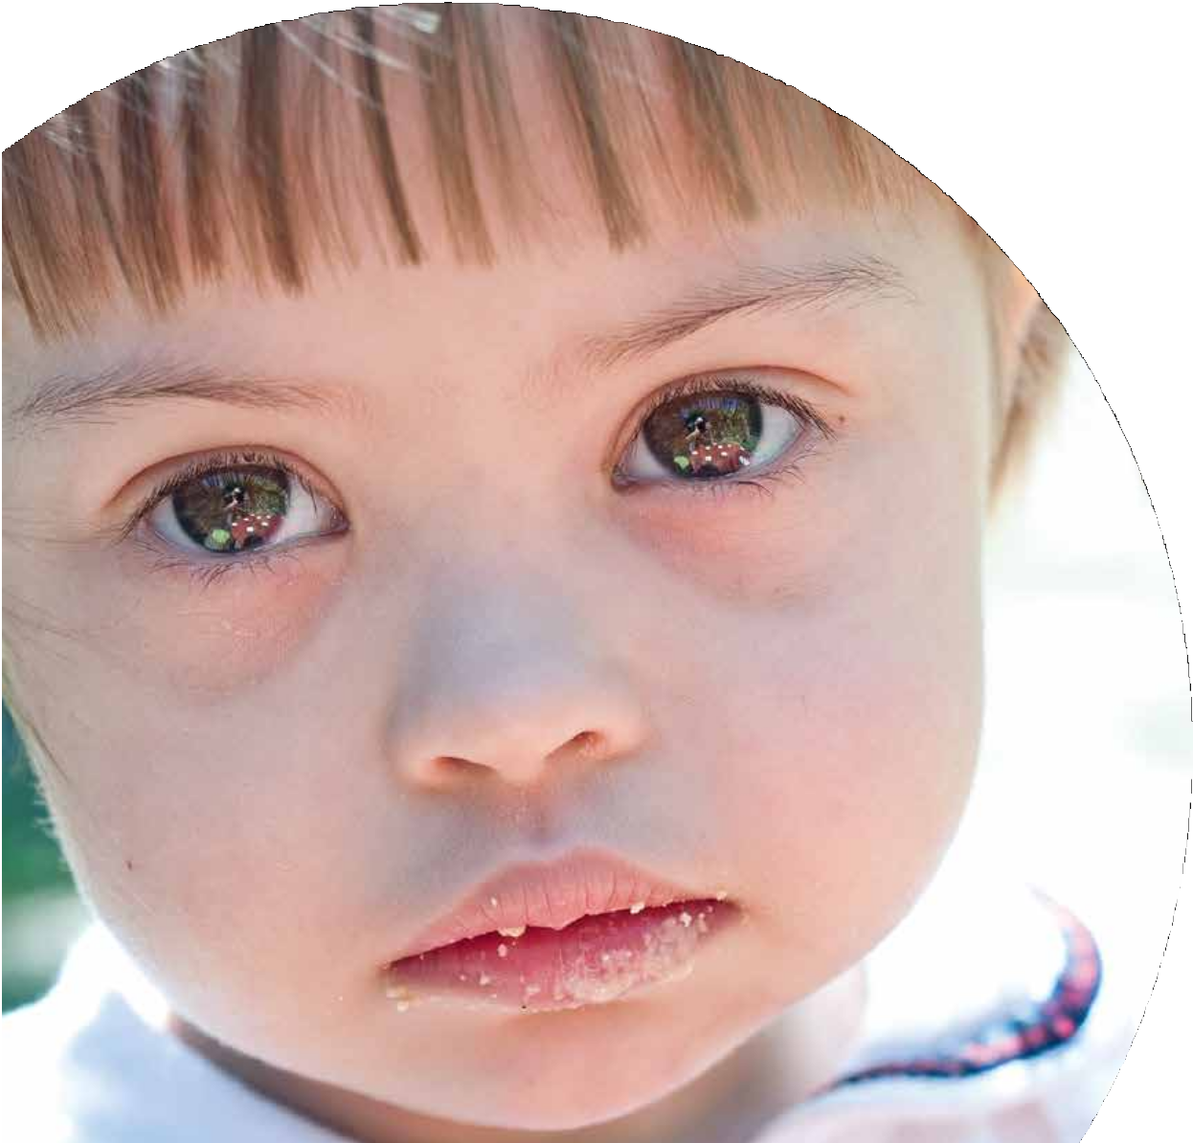

Multumesc!

