Slide 1


Annual Report on Official Development Assistance offered to the Health Sector of the Republic of Moldova 2016
9th Edition
Ministerul Sănătății Republica Moldova

Slide 2
Report Objectives
to picture donors alignment towards the Moldovan health system strategies
to improve quality of information available for sector coordination and strategic decision-making for strategic planning of financial resources in health sector
to provide evidences to strengthen donor coordination mechanism towards the on-going reforms in the Moldovan health sector
to illustrate donors’ short and medium term commitments to the Moldovan health sector
to inform on future sectorial strategic plans and donors’ strategies to support the MOH of the RM

Slide 3
Development partners 2016
Multilateral
Bilateral
European Union
UNFPA
Government of Norway
Government of Romania
Global Fund
UNODC
Government of Japan/JICA
GAVI
UNECE
Government of Czech Republic
UNDP
WHO
Government of Turkey/TIKA
UNAIDS
WB
Government of Switzerland/SDC
UNICEF
IAEA
Government of FRG/GIZ

Slide 4
Donors interviewed
Agency | 2011 | 2012 | 2013 | 2014 | 2015 | 2016
Council of Europe |  |  | + | +
Council of Europe Development Bank (CEB) |  | + | + | +
European Union (EU) | + | + | + | + | + | +
German Society for International Cooperation (GIZ) | + | + | + | + | + | +
Global Alliance for Vaccines and Immunization (GAVI) | + | + | + | + | +
Global Fund to Fight AIDS, Tuberculosis and Malaria (GF) | + | + | + | + | + | +
Government of Austria / Austrian Development Agency (ADA) | + | + | + | +
Government of China | + | + | +
Government of Estonia |  | + | + | +
Government of Japan |  | + | + | + | + | +
Government of Romania | + | + | + | + | + | +
International Atomic Energy Agency (IAEA) |  | + | + | + | + | +
Joint United Nations Programme on HIV/AIDS (UNAIDS) | + | + | + | + | + | +
Swiss Agency for Development and Cooperation (SDC) | + | + | + | + | + | +
Turkish International Cooperation and Development Agency (TIKA) | + | + | + | + | + | +
United Nations Development Programme (UNDP) | + | + | + | + |  | +
United Nations Children’s Fund (UNICEF) | + | + | + | + | + | +
United Nations Economic Commission for Europe (UNECE) |  | + | + | + | + | +
United Nations Population Fund (UNFPA) | + | + | + | + | + | +
United Nations Office on Drugs and Crime (UNODC) | + | + | + | + | + | +
World Bank (WB) | + | + | + | + | + | +
World Health Organization (WHO) | + | + | + | + | + | +
Government of Norway |  |  |  |  | +
Government of Czech Republic |  |  |  |  | + | +

Slide 5
Overall ODA disbursed per donor and by type of disbursement 2016

Slide 6
Type of Funding
Notes:
Since its creation in 1961, the OECD Development Assistance Committee has worked to improve the effectiveness of its members’ aid efforts. One major issue has been whether aid should be freely available to buy goods and services from all countries (“untied aid”), or whether aid should be restricted to the procurement of goods and services from the donor country (“tied aid”).
Work culminated in a Recommendation to Untie Official Development Assistance to the Least Developed Countries (DAC High Level Meeting, April 2001).
The objectives of this recommendation are to:
untied ODA to the least developed countries to the greatest extent possible
promote and ensure adequate ODA flows, in particular to the least developed countries
achieve balanced efforts among DAC Members in untying aid
The recommendation calls upon donors to make developing countries responsible for procurement. A list of untied official development assistance contract opportunities allows the private sector to compete for aid-funded contracts.

Slide 7
Type of funding

Slide 8
Grants and loans
US$ equivalent, 2011 – 2016

Slide 9
Type of mechanism by which ODA is provided
US$ equivalent, 2011 - 2016

Slide 10
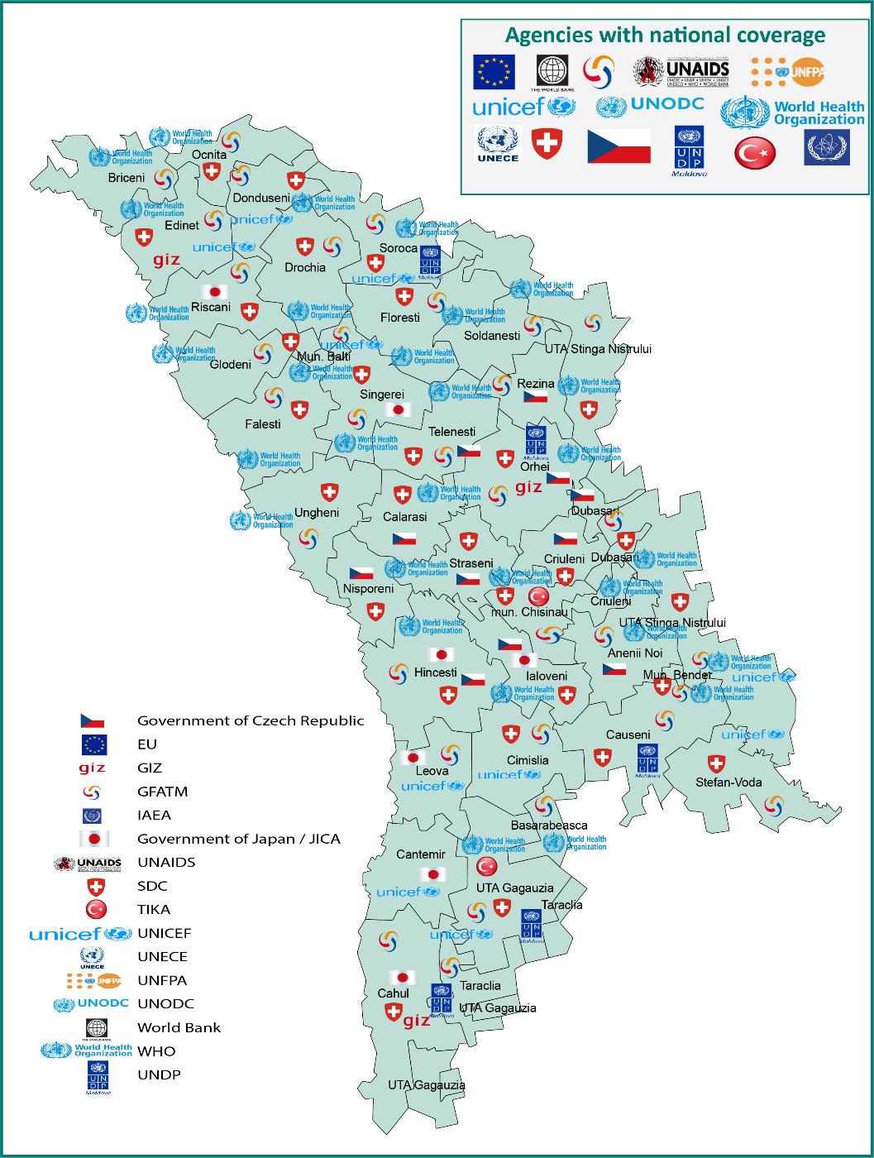
Geographic coverage
Ministerul Sănătății Republica Moldova

Slide 11
Type of funding
% of funds disbursed, 2011 - 2016

Slide 12
Investments
% of funds disbursed for Investments in
2011- 2016

Slide 13
Technical assistance
% of funds disbursed for Technical assistance in 2011- 2016

Slide 14
ODA distribution to Health System Core Functions
% of total funds disbursed in
2011- 2016

Slide 15
ODA provided for Health Service Provision
% of funds disbursed for Health Service
Provision in 2011 - 2016

Slide 16
ODA distribution against Public health priority areas
% of total funds disbursed in 2016

Slide 17
Alignment of ODA to national health policies
Health policy, strategy or programme | Development partners (total number)
1.1. National Health Policy, 2007-2021 | WB; GIZ; Czech Government; Japan Government; Romania Government; WHO; UNDP; SDC; TIKA; UNAIDS; UNECE; UNFPA; UNICEF; UNODC; (14)
1.2. Health Systems Development Strategy, 2008-2017 | IAEA; WB; GIZ; Japan Government; Romania Government; WHO; UNDP; SDC; TIKA; EU; UNECE; UNFPA; UNICEF; UNODC; (14)
2.1. National Anti-Drug Strategy, 2011-2018 | UNAIDS; UNODC; (2)
3.1. State Policy on Pharmaceuticals | WHO; (1)
3.2. National Public Health Strategy, 2014-2020 | WB; Romania Government; WHO; UNDP; SDC; UNAIDS; UNECE; UNFPA; UNICEF; UNODC; (10)
3.3. Institutional Development Strategy of the National Health Insurance Company, 2013-2017 | SDC; (1)
4.1. National Program for Viral Hepatitis B, C and D Control, 2012-2016
4.2. National Program for Health Lifestyle Promotion, 2016-2020 | IAEA; SDC; UNAIDS; UNFPA; (4)
4.3. National Program for Mental Health, 2012-2016 | WHO; SDC; (2)
4.4. National Blood Transfusion Safety Program, 2012-2016
4.5. National Immunizations Program, 2016-2020 | WHO; SDC; UNICEF; (3)
4.6. National HIV/AIDS and STI Prevention Program, 2016-2020 | GF; WHO; UNDP; UNAIDS; UNFPA; UNICEF; UNODC; (7)
4.7. National TB Prevention and Control Program, 2016-2020 | GF; WHO; UNDP; (3)
4.8. National Program for Emergency Care Development, 2016-2020 | SDC; (1)
4.9. National Program for Tobacco control 2012-2016 | WB; WHO; SDC; (3)
4.10. National Program for Alcohol control 2012-2020 | WHO; SDC; (2)
4.11. National Program for Transplant 2012-2016 | EU; (1)
4.12. National Program on Iron and Folic Acid Deficiencies 2012-2017
4.13. National Prevention and Control Program for Cardiovascular Diseases, 2014-2020 | WHO; SDC; (2)
4.14. National Program in the field of Food and Nutrition, 2014-2020 | SDC; UNICEF; (2)
4.15. National Program for Prevention and Reduction of the morbidity and mortality of children with congenital malformations and hereditary pathologies, 2013-2017
4.16. National Program for Cancer Control, 2016-2025 | WHO; SDC; UNFPA; (3)

Slide 18
ODA implementation using national procedures
US$ equivalent, 2011 - 2016

Slide 19
Alignment of ODA to MTBF categories 2016

Slide 20
Aid Predictability
Scheduled and actual ODA disbursements
US$ equivalent, 2011 - 2016

Slide 21
Donor coordination and complementarity
Joint missions
Number of missions, 2016

Slide 22
Donor coordination and complementarity
Analytical works

Slide 23
Number of projects and closing year

Slide 24
Number of development partners and plans for continuation

Slide 25
Findings
In 2016 donors have disbursed an equivalent of US$ 30.6 million, which is a 8.6% adding to the overall public health expenditure, estimated at US$ 327.4 million. If compared to the 2015 assessment, the ODA contribution to the total health sector public expenditure was higher by about 2% in 2016 (6.7% ODA to the US$ 338.7 million public spent in 2015)
The share of ODA in form of soft loans has considerably increased and almost reached the level of 2013 year, - 29% of the total funds in 2016 (11% in 2015; 50% in 2014; 33% in 2013; 38% in 2012, and only 11% in 2011).
The technical assistance decreased by 5.4% in 2016, and represents 36.4%, compared to 41.8% in 2015
Investment component increased to 58.2% in 2016, after the dramatic fall to to 50.1% in 2015
Of note is the fact that administrative costs decreased after a stable trend of 8% in 2014 and 2015 and reached the levels of 2012 (5.1%) and 2013 (4.6%) and represent 5.4% in 2016

Slide 26
Findings
Due to the fall of investments in the hospital sector it is observed the switch between the resource generation (increase by 30%) and health service delivery (decrease by 24.5%) categories, thus both categories continued to account for the larger share of the donor assistance scrutinized until now, thus in real terms health service delivery category increased 2 times in real terms.
Of note is that Leadership&Governance category decreased by 5% in 2016 (7.6%) compared to 2015 level, thus in real term the decrease is 18%.
ODA to hospital sector as a share of total expenditure doubled in 2016 compared to the fall to 32.6% in 2015.
The primary health care in 2016 decreased by 7% compared to 2015 (40.8%) thus in real terms the financing decreased by 26%.
The almost 4 times decrease in the financing for public health care actually represents the same decrease in real terms.
The disbursements to emergency care dropped down by 7 times in 2016 compared to 2015 and decreased 9 times in real terms.

Slide 27
Findings
Non-Communicable diseases account the largest share in 2016 being at the level of 66% from the total.
Communicable diseases share accounts for the 2nd share being (22.2%), a drop in disbursements by 4 times less in real terms compared to the level of 2015.
MCH & Reproductive health decreased 2 times in comparison with the level of 16,1% in 2015 being 8.2 % in 2016, thus in real terms decreased 3 times.
Injuries and Violence have the lower attention from the development partners and account only 0.1% of total share.
Adolescent health category decreased to 0.3% in 2016 compared to 6.2% in 2015

Slide 28
Findings
In terms of Geographical Coverage, the distribution in this edition is more uniform and there is no regions not covered by ODA assistance
In health sector, donors aligned well to support priorities in national health policies and national programs, however some national strategies and programmes receive less attention as the last years, such as the areas related to Pharmaceuticals, Hepatitis, Diabetes and Cardiovascular diseases and National Blood Transfusion Safety Program
The resource distribution by MTBF categories picture top two categories: hospital and PHC for the public support during the last 3 years; followed by Outpatient specialized care and National and Special Health Programs.
The National and Special Health Programs and Hospital Care are the categories which are the first choice of partners support (2013,2014,2015, 2016).

Slide 29
Findings
Checked against the Busan commitments and the Global Partnership Monitoring Framework
1. If to consider all the national strategic health planning documents as country results framework: all the development partners are aligned to the health policy priorities
6 out of 17 (35.2%) development partners are active in the sector and disburse funds thru NGO’s
5. a. The ratio of planned to disbursed fund is (0,7% - 2016) thus being different as the situation in the precedent two years (disbursed greater then scheduled).
b. Out 17 development partners 11 (65%) provided exact amount of future disbursement for the next 3 years, out of them 7 (64%) stated the areas of interest
Notes:
4 key principles:
Ownership of development priorities
Focus on results
Inclusive development partnerships
Transparency & Accountability
10 indicators:
(6, 9, 10) 6- 20% recorded in the annual state budget

Slide 30
Findings
Checked against the Busan commitments and the Global Partnership Monitoring Framework
The proportion of funds recorded in the national accounting was over 60% in the precedent 3 years before 2015 (30%), in 2016 this indicator was 46%;
.b. The use of country PFM – 13.3%, it is the lowest level registered, compared to - 26.4% in 2015; 25.3% in 2014, 65.2% in 2013;
10. Nobody reported under tied category (0%).

Slide 31
Findings
The Joint Missions target recorded 55% in 2016 of the total missions, thus it greater than the recommended at least 40% mentioned in the Paris Declaration.
The joint country Analytic Work indicator reached 84.2% in 2016, against the 66% target indicated by the Paris Declaration.

Slide 32

Thank you for your attention
MINISTERUL SĂNĂTĂŢII AL REPUBLICII MOLDOVA

