Slide 1


Annual Report on Official Development Assistance offered to the Health Sector of the Republic of Moldova 2017
10th Edition
Ministerul Sănătății, MUNCII ȘI PROTECȚIEI SOCIALE AL RepublicII Moldova

Slide 2
Report Objectives
to picture donors alignment towards the Moldovan health system strategies
to improve quality of information available for sector coordination and strategic decision-making for strategic planning of financial resources in health sector
to provide evidences to strengthen donor coordination mechanism towards the on-going reforms in the Moldovan health sector
to illustrate donors’ short and medium term commitments to the Moldovan health sector
to inform on future sectorial strategic plans and donors’ strategies to support the MHLSP of the RM

Slide 3
Development partners 2017
Multilateral
Bilateral
European Union
UNFPA
Government of norway
UNODC
Government of Romania
Global Fund
Government of Japan/JICA
WHO
GAVI
Government of czech republic
WB
Government of Turkey/TIKA
UNAIDS
UNDP
Government of Switzerland/SDC
UNICEF
IAEA
Government of FRG/GIZ

Slide 4
Key Results
MINISTRY OF HEALTH OF THE
REPUBLIC OF MOLDOVA

Slide 5
Donors interviewed
Agency | 2011 | 2012 | 2013 | 2014 | 2015 | 2016 | 2017
Council of Europe |  |  | + | +
Council of Europe Development Bank (CEB) |  | + | + | +
European Union (EU) | + | + | + | + | + | + | +
German Society for International Cooperation (GIZ) | + | + | + | + | + | + | +
Global Alliance for Vaccines and Immunization (GAVI) | + | + | + | + | + |  | +
Global Fund to Fight AIDS, Tuberculosis and Malaria (GF) | + | + | + | + | + | + | +
Government of Austria / Austrian Development Agency (ADA) | + | + | + | +
Government of China | + | + | +
Government of Estonia |  | + | + | +
Government of Japan |  | + | + | + | + | + | +
Government of Romania | + | + | + | + | + | + | +
International Atomic Energy Agency (IAEA) |  | + | + | + | + | + | +
Joint United Nations Programme on HIV/AIDS (UNAIDS) | + | + | + | + | + | + | +
Swiss Agency for Development and Cooperation (SDC) | + | + | + | + | + | + | +
Turkish International Cooperation and Development Agency (TIKA) | + | + | + | + | + | + | +
United Nations Development Programme (UNDP) | + | + | + | + |  | +
United Nations Children’s Fund (UNICEF) | + | + | + | + | + | + | +
United Nations Economic Commission for Europe (UNECE) |  | + | + | + | + | +
United Nations Population Fund (UNFPA) | + | + | + | + | + | + | +
United Nations Office on Drugs and Crime (UNODC) | + | + | + | + | + | + | +
World Bank (WB) | + | + | + | + | + | + | +
World Health Organization (WHO) | + | + | + | + | + | + | +
Government of Norway |  |  |  |  | + |  | +
Government of Czech Republic |  |  |  |  | + | + | +

Slide 6
Overall ODA disbursed per donor and by type of disbursement 2017

Slide 7
Type of Funding

Slide 8
Type of funding

Slide 9
Grants and loans
US$ equivalent, 2011 – 2017

Slide 10
Type of mechanism by which ODA is provided
US$ equivalent, 2011 - 2017

Slide 11
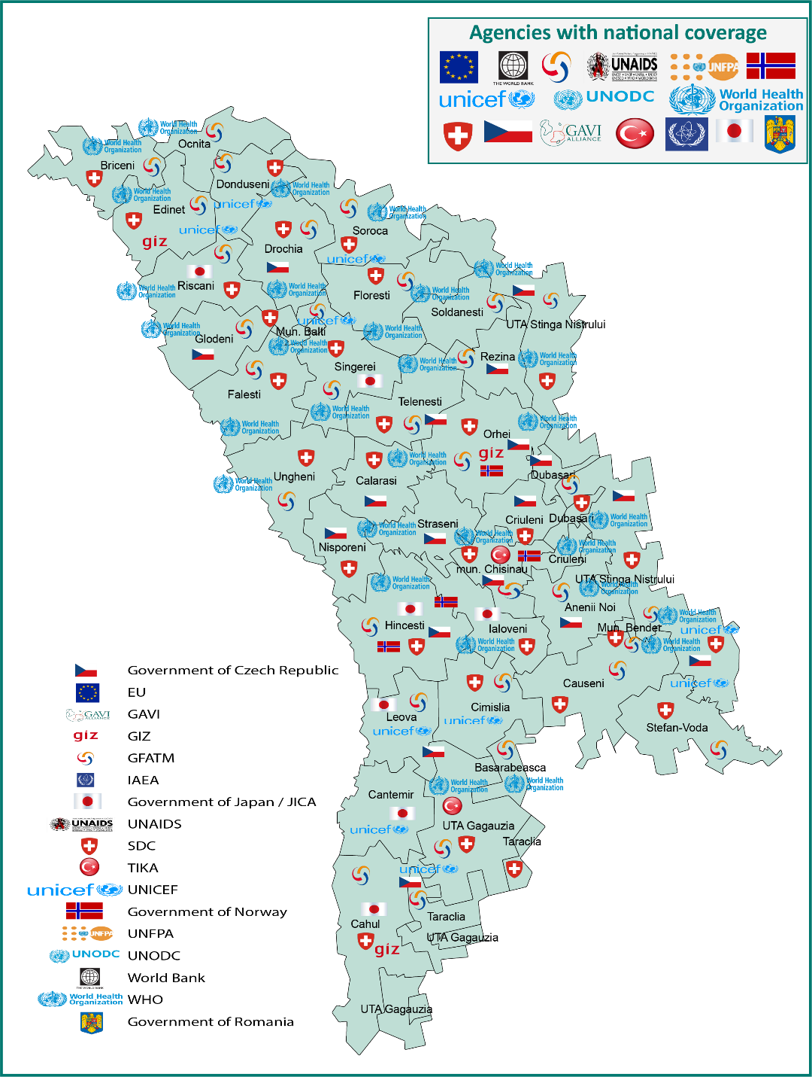
Geographic coverage
Ministerul Sănătății, Muncii Și Protecției sociale AL RepublicII Moldova

Slide 12
Type of funding
% of funds disbursed, 2011 - 2017

Slide 13
Investments
% of funds disbursed for Investments in
2011- 2017

Slide 14
Technical assistance
% of funds disbursed for Technical assistance in 2011- 2017

Slide 15
ODA distribution to Health System Core Functions
% of total funds disbursed in
2011- 2017

Slide 16
ODA provided for Health Service Provision
% of funds disbursed for Health Service
Provision in 2011 - 2017

Slide 17
ODA distribution against Public health priority areas (2016 , 2017)
2016
2017
% of total funds disbursed

Slide 18
Alignment of ODA to national health policies
Health policy, strategy or programme | Development partners (total number)
National Health Policy, 2007-2021 | WB; GF; GAVI; GIZ; Czech Government; Japan Government; Romania Government; WHO; SDC; TIKA; UNAIDS; UNFPA; UNICEF; UNODC; (14)
Health Systems Development Strategy, 2008-2017 | IAEA; WB; GIZ; Japan Government; WHO; SDC; UNFPA; UNAIDS; UNICEF; UNODC; (10)
National Anti-Drug Strategy, 2011-2018 | UNICEF; UNODC; (2)
State Policy on Pharmaceuticals | WHO; EU (2)
National Public Health Strategy, 2014-2020 | WHO; SDC; UNAIDS; TIKA (4)
Institutional Development Strategy of the National Health Insurance Company, 2015-2019 | WHO; SDC; (2)
Health System Human Resources Development Strategy, 2016-2025 | SDC (1)
National Program for Viral Hepatitis B, C and D Control, 2017-2021 | WHO; (1)
National Program for Health Lifestyle Promotion, 2016-2020 | SDC; UNFPA; UNICEF (3)
National Program for Mental Health, 2017-2021 | WHO; SDC (2)
National Blood Transfusion Safety Program, 2017-2021
National Immunizations Program, 2016-2020 | GAVI; WHO; SDC; UNICEF; (4)
National HIV/AIDS and STI Prevention Program, 2016-2020 | GF; WHO;UNAIDS; UNFPA; UNICEF; UNODC (6)
National TB Prevention and Control Program, 2016-2020 | GF; WHO; (2)
National Program for Emergency Care Development, 2016-2020 | SDC; (1)
National Program for Tobacco control 2017-2021 | WB; WHO; SDC; UNICEF (4)
National Program for Alcohol control 2012-2020 | WHO; SDC; UNICEF; (3)
National Program for Transplant 20127-2021
National Program on Iron and Folic Acid Deficiencies 2012-2017 | UNICEF; (1)
National Prevention and Control Program for Cardio-vascular Diseases, 2014-2020 | WHO; SDC; (2)
National Program in the field of Food and Nutrition, 2014-2020 | SDC; UNICEF (2)
National Program for Prevention and Reduction of the morbidity and mortality of children with congenital malformations and hereditary pathologies, 2013-2017 | Romanian Government; WHO; UNICEF; (3)
National Programme for Cancer Control, 2016-2025 | IAEA; WHO; SDC; UNFPA (4)
National Program for the Prevention and Control of Diabetes Mellitus, 2017-2021 | SDC (1)

Slide 19
ODA implementation using national procedures
US$ equivalent, 2011 - 2017

Slide 20
Alignment of ODA to MTBF categories 2017

Slide 21
Aid Predictability
Scheduled and actual ODA disbursements
US$ equivalent, 2011 - 2017

Slide 22
Donor coordination and complementarity
Joint missions
Number of missions, 2017

Slide 23
Donor coordination and complementarity
Analytical works

Slide 24
Number of projects and closing year

Slide 25
Number of development partners and plans for continuation

Slide 26
Findings
In 2017 donors have disbursed an equivalent of US$ 32.2 million, which is a 7.6% adding to the overall public health expenditure, estimated at US$ 423.4 million. If compared to the 2016 assessment, the ODA contribution to the total health sector public expenditure was lower by 1% in 2017 (8.6% ODA to the US$ 327.4 million public spent in 2016), but in real terms the disbursed amount was higher with an equivalent of US$ 1.2 million
The share of ODA in form of soft loans has considerably decreased and represents 5.5% of total funds in 2017. This is the smallest share from the time the ODA surveys are conducted.
The technical assistance increased by 6.7% in 2017, and represents 43.1%, compared to 36.4% in 2016
Investment component decreased to 49.8% in 2017, and represents the smallest share of ODA for investments beginning with 2011
Of note is the fact that administrative costs increased to 7% in 2017 in comparison with 5.4% in 2016

Slide 27
Findings
Due to the increase of investments in the hospital sector it is observed the switch between the health service delivery category (increased by 1,4%, registering 68,2%) and resource generation (decrease by 8.1%) and show 15.3%, but in real terms it increased 2 times.
Health financing category slightly increased while Leadership&Governance category increased by 6.2% in 2017 (amounting 13.8%) compared to 2016 level, and in real terms it increased almost two times.
ODA to hospital sector as a share of total expenditure decreased by 2.2% in 2017 compared to the previous year, and in real terms the financing remains at the same level.
The ODA to primary health care in 2017 slightly increased by 71.9% compared to 2016 (33.5%), thus in real terms the disbursements remained at the same level.
The financing for public health care actually slightly increased to 5.8% this year, and in real terms the disbursements for this category remains at the same level.
The disbursements to emergency care dropped down by 0.4% in 2017 compared to 2016 and decreased 2 times in real terms.

Slide 28
Findings
Communicable diseases account the largest share in 2017 being at the level of 29.1% from the total ODA Disbursed.
Non-Communicable diseases category accounts for the 2nd share being only 15.7%, and registered a two times decrease in real terms compared to the level of 2016.
MCH & Reproductive health increased 2 times in comparison with the level of 4.7%% in 2016 being 10.4% % in 2017, thus in real terms it increased two times.
Injuries and Violence have the lower attention from the development partners and account only 0.2% of total share, but in real terms it increased four times.
Adolescent health category increased to 0.7% in 2017 compared to 0.2% in 2016.

Slide 29
Findings
In terms of Geographical Coverage, the distribution of donors support is uniform and there are no regions not covered by ODA assistance in the last 3 years.
In health sector, donors aligned well to support priorities in national health policies and national programs, however some national strategies and programmes receive less attention as the last years, such as the areas related to Transplant and National Blood Transfusion Safety Programs.
The resource distribution by MTBF categories picture top two categories: hospital and PHC for the public support during the last 3 years; followed by Outpatient specialized care and Emergency Pre-hospital Medical Care.
The National and Special Health Programs, Primary Health Care and Hospital Care are the categories which are the first choice of partners support in the last 5 years.

Slide 30
Findings
Checked against the Busan commitments and the Global Partnership Monitoring Framework
1. If to consider all the national strategic health planning documents as country results framework: all the development partners are aligned to the health policy priorities
4 out of 17 (28.6%) development partners are active in the sector and disburse funds through NGO’s
5. a. The ratio of planned to disbursed fund is shows a difference of - 0.2% meaning that disbursed amount was greater that the planned one.
b. Out 17 development partners 12 (70%) provided exact amount of future disbursement for the next years, all of them (100 %) stated the areas of interest

Slide 31
Findings
Checked against the Busan commitments and the Global Partnership Monitoring Framework
The proportion of funds recorded in the national accounting was the lowest from the beginning of ODA survey (2011) and shows 29.1%, in 2016 this indicator was 46%;
.b. The use of country PFM – 29.3%, it is the highest level registered, compared to the last 4 years – 13.3% in 2016; 26.4% in 2015; 25.3% in 2014;
10. 2 Donors reported under tied category (11.8%).

Slide 32
Findings
The Joint Missions target recorded 35% in 2017 of the total missions, thus it less than the recommended at least 40% mentioned in the Paris Declaration.
The joint country Analytic Work indicator reached 55% in 2017, against the 66% target indicated by the Paris Declaration.

Slide 33

Thank you for your attention
MINISTERUL SĂNĂTĂŢII, MUNCII ȘI PROTECȚIEI SOCIALE AL REPUBLICII MOLDOVA

