Slide 1




MINISTERUL SĂNĂTĂŢII AL REPUBLICII MOLDOVA
Healthy Life Project
Reducing the Burden of Non-Communicable Diseases
Dr. Lajos Kovacs
Team Leader
Health Sector Council Meeting in the field of External Assistance
13 April 2017, Ministry of Health, Chisinau, Moldova

Slide 2
Healthy Life Project -
Reducing the Burden of Non-Communicable Diseases
Funded by Swiss Agency for Development and Cooperation
Implemented by Swiss Tropical and Public Health Institute and CRED
Project duration 01.07.2016 – 30.06.2020
Project budget 4.5 million CHF

Slide 3
Overall objective
To contribute to the improvement of health status of the Moldovan population, especially in rural areas through reduction of burden of NCDs

Slide 4
Main partners
Ministry of Health
National Health Insurance Company
National Centre for Public Health
National Centre for Health Management
State University of Medicine and Pharmacy
Centre of Excellence in Medicine and Pharmacy
Medical Colleges
School of Public Health Management
Continuous Medical Educational Centre for Nurses and Midwives
Local Healthcare Institutions
Rayon Centres of Public Health
Individuals, families and communities

Slide 5
Focus: Health Promotion
Health promotion is the process of enabling people to increase control over, and to improve, their health. It moves beyond a focus on individual behaviour towards a wide range of social and environmental interventions. (WHO)
Health is a responsibility
Health promotion is subject to community based, multisectoral collaboration
Multi-level activities address specific target groups (e.g. maternal and child health, school health, youth health, risk groups, NCDs patients)
Institutional base and collaborating partners (e.g. Public Health Centres and Task Forces, and other partners working in synergy)
Health literacy, health education, health communication, etc.
Social networks and media
Sustainability – What are the sources of funding and how is the fund allocated? Is the funding mechanism based on cost-effectiveness and cost-efficiency analyses? Are there incentives inbuilt in the financing system?

Slide 6
Principles
Aligned with the National Health Policy
Complementary to existing interventions
Translate national strategies into local action
Implementation through local and national institutions and communities
Generate evidence from implementation to improve national strategies

Slide 7
Project Planning – Background (1)
Demographic challenges – low natural growth, ageing population and migration of the working-age population
Noncommunicable diseases – leading cause of death and disability; primary burden related to hypertension, diabetes and respiratory illnesses
Ministry of Health has national protocols and strategies to address the major challenges through curative care, and some efforts to establish multi- and intersectoral collaboration, including the coordination of public health activities through territorial Public Health Task Forces
Strengthening Public Health System – needs to include institutional capacity building of National and Rayon Public Health Centres, and public health programmes (e.g. disease prevention through immunization, or alcohol/tobacco control)

Slide 8
Project Planning – Background (2)
Health Promotion – traditional approaches used to date by the national programme, however specific activities and action plans at rayon level demonstrate some experience in diverse approaches
Health Education – training of staff of Public Health Centres as well as education materials and awareness raising for the public is needed
Health Communication – through MoH and health institutions, other ministries and institutions, local authorities, NGOs, and social networks
Public Health Research – data collection and analysis, needs assessment, programme monitoring and evaluation

Slide 9
Project Priority Areas (1)
Clinical Protocols
  Review existing materials and guidelines for Family Physicians and nurses on NCDs to provide for patient education and case management (in collaboration with WHO/PEN protocols)
  Develop materials for patient information regarding NCDs management to complement PEN protocols
Community Nursing
  Facilitate the development of concept of Community Nursing, professional profile and qualification standards, and review existing curriculum

Slide 10
Project Priority Areas (2)
3. Building Capacities of Public Health Centres
  Support capacity building of Public Health Centres on health promotion through staff training and institutional development
  Strengthen Public Health Task Forces at rayon level to coordinate health promotion activities across sectors with diverse stakeholders
4. Health Promotion
  Analyse health promotion, identify health problems, assess training needs, raise awareness, etc. (health profiles, district health teams, district public health councils)

Slide 11
Project Outcomes
Outcome 1
National health authorities create an for enabling policy environment decentralized and integrated management of NCDs
Outcome 2
The population in target districts has access to and uses quality integrated care, including outreach services, related to NCDs
Outcome 3
The population in target districts has improved health seeking behaviour and reduced NCDs risk behaviour

Slide 12
Project Progress to Date – Inception Phase
Document review
Health Care Laws, Regulations, Strategies, Policies and Plans
Reports, studies, etc. from donor agencies/development partners
Development partner plans and project documents
Relevant international literature
Gap Analysis
Stakeholder analysis
Governmental institutions, development partners, NGOs/CBOs
Local authorities, raion administration
Studies
    Policy and regulatory environment
Community interventions, social care
Primary Health Care
Stakeholder workshop
  Chisinau, 20 January 2016

Slide 13
Project Progress to Date – Implementation Phase
Project Management
Recruitment of International Staff – Team Leader
Establish organizational base for local operations – CRED Moldova
Establish a Project Office - PFU
Recruit Local Support Staff and Experts
Project Partner and stakeholder Meetings
Governance
Memorandum of Understanding between SDC and MoH signed on 16 January 2017
Pilot Rayons
Selection of 4 Pilot Rayons – 15 December 2016
Selection of 6 Pilot Rayons – 28 February 2017
1st Pilot Rayon Workshop – 11 April 2017
Planning
Annual Plan of Action, and Monitoring and Evaluation Plan for 2017

Slide 14
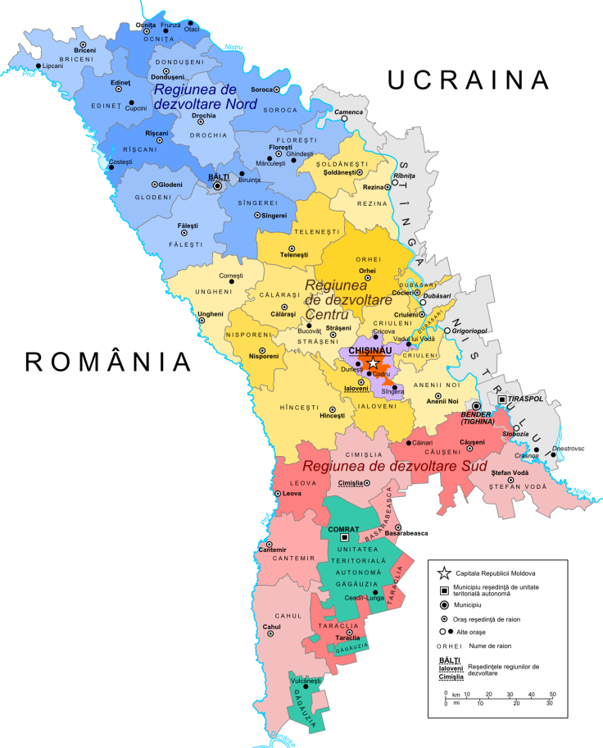
Pilot Rayons
From 1st year | From 2nd year
Northern Region (N)
1. Falesti | 5. Briceni
 | 6. Edinet
Central Region (C)
2. Ungheni | 7. Orhei
 | 8. Criuleni
Southern Region (S)
3. Cahul | 9. Taraclia
4. Stefan Voda | 10. Vulcanesti

Slide 15
Next Steps
Facilitate the analysis and use of health profiles at rayon level to identify subpopulations with specific health risks and needs
Develop a health action plan to meet the needs of these priority subpopulations
Strengthen local capacities and capacity of Public Health Centres to design and conduct targeted health promotion, and to coordinate health promotion actions locally
Develop local partnership amongst multisectoral partners at rayon level to collectively address priority health issues in the communities related to NCDs

Slide 16
Challenges
Reform of the Primary Health Care and the Public Health system
Competing notions of nursing
Lack of familiarity with the most recent evidence on effective health promotion, and changing financing modalities that could affect the motivation of providers

Slide 17
Thank you for your kind attention!
str. Maria Cibotari 6, MD-2012,
Chișinău, Republica Moldova
info@viatasan.md
http://www.viatasan.md

